Slide 1
29. CONTENT DELIVERY NETWORK (CDN)
A content delivery network (CDN) is a system of distributed servers (network) that deliver webpages and other web content to a user based on the geographic locations of the user, the origin of the webpage and a content delivery server.
Amazon CloudFront can be used to deliver your entire website, including dynamic, static, streaming, and interactive content using a global network of Amazon edge locations.
Requests for your website or application are automatically routed to the nearest edge locations instead of your servers, so content is delivered with the best possible performance.
Origin: This is the origin of all files that the CDN will distribute. This can be either an EC2 Instance, S3 Bucket, an ELB or Route53.
Distribution: This is the name given the CDN which consists of a collection of Edge Locations.
CLOUDFRONT Distribution Types:
Web Distribution: Typically used for Websites.
RTMP: Used for Media Streaming.

Slide 2
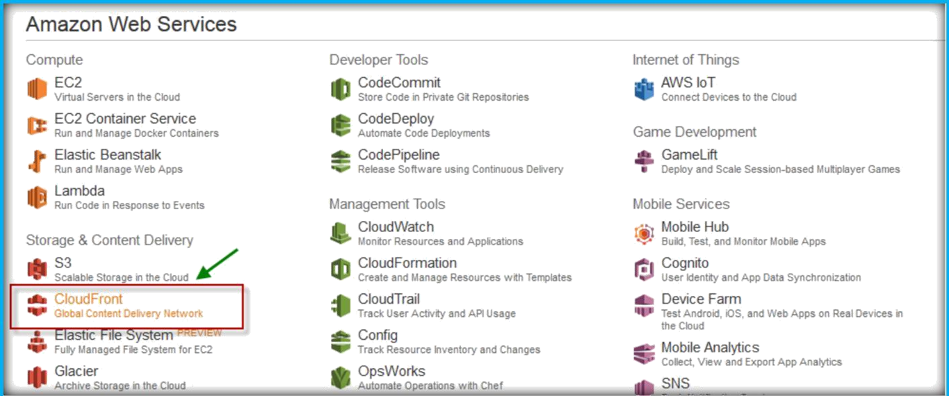
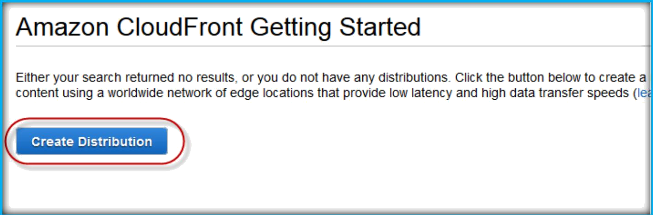
CLOUDFRONT DISTRIBUTION CREATION
Once you logged in to AWS management console, from the console home choose CloudFront under Storage & Content Delivery.
Choose Create Distribution button to create a new one.

Slide 3
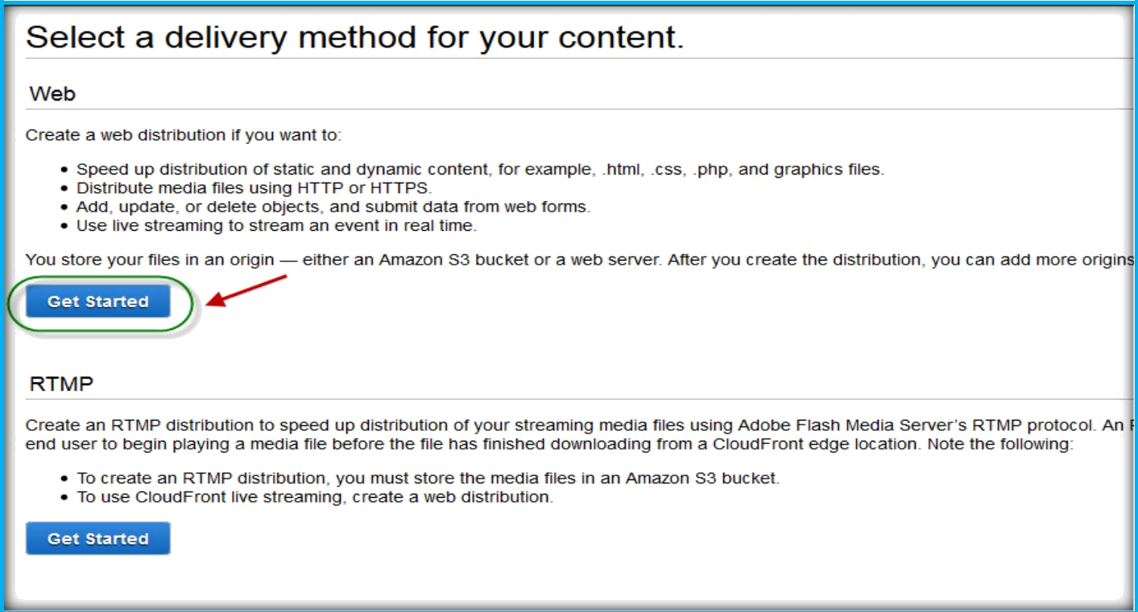
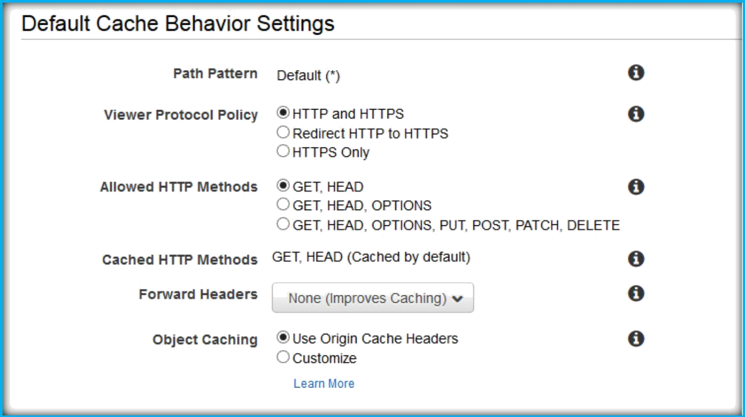
From the select delivery method page, choose Get Started under Web.
Under Origin settings, specify Origin Domain name.
Under Default cache behavior settings left all as defaults till Object Caching.

Slide 4
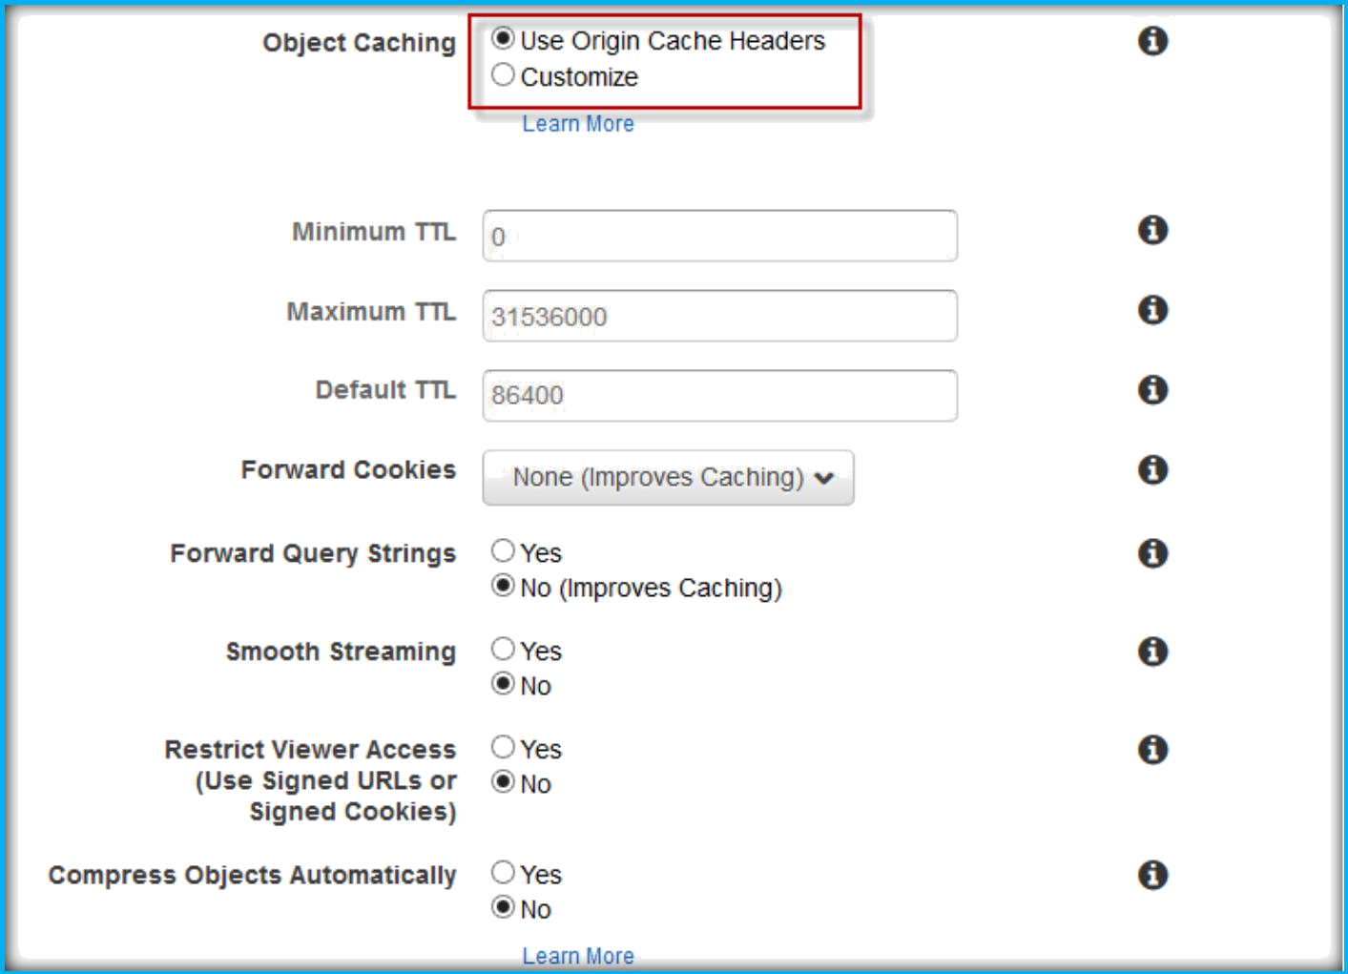
Under Object Caching, if you want to change choose Custom, then specify Minimum, maximum and Default TTL values.

Slide 5
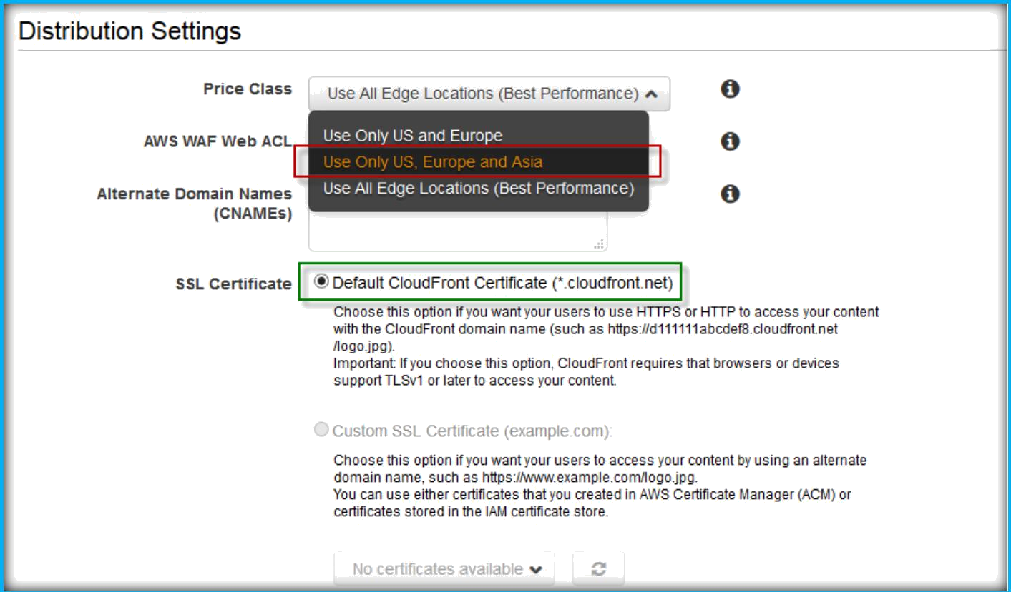
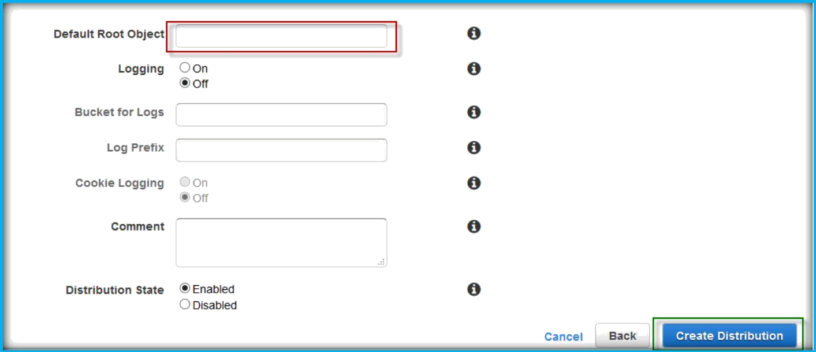
Under Distribution Settings, from Price class drop down list choose one of the option which suits better for your application. Then under SSL Certificate, go with defaults.
Then specify Default root object or leave blank, specify logging should be on or off.
Then choose Create Distribution button to create.

Slide 6
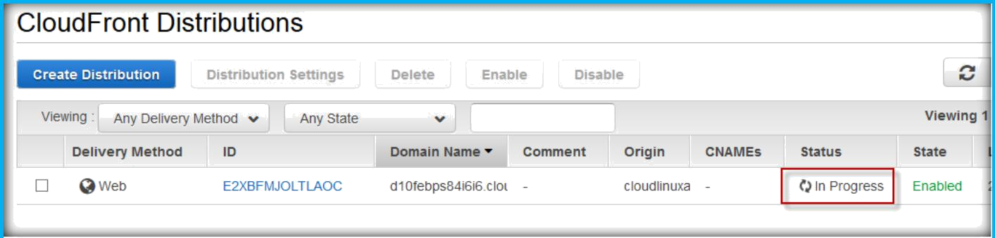
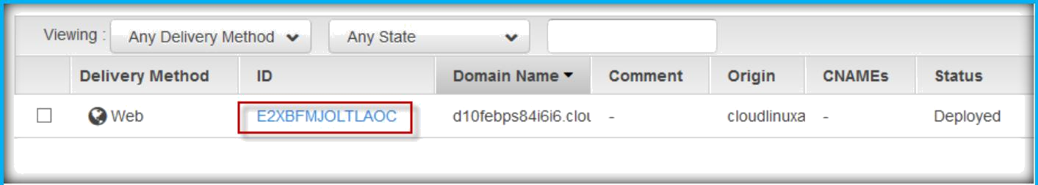
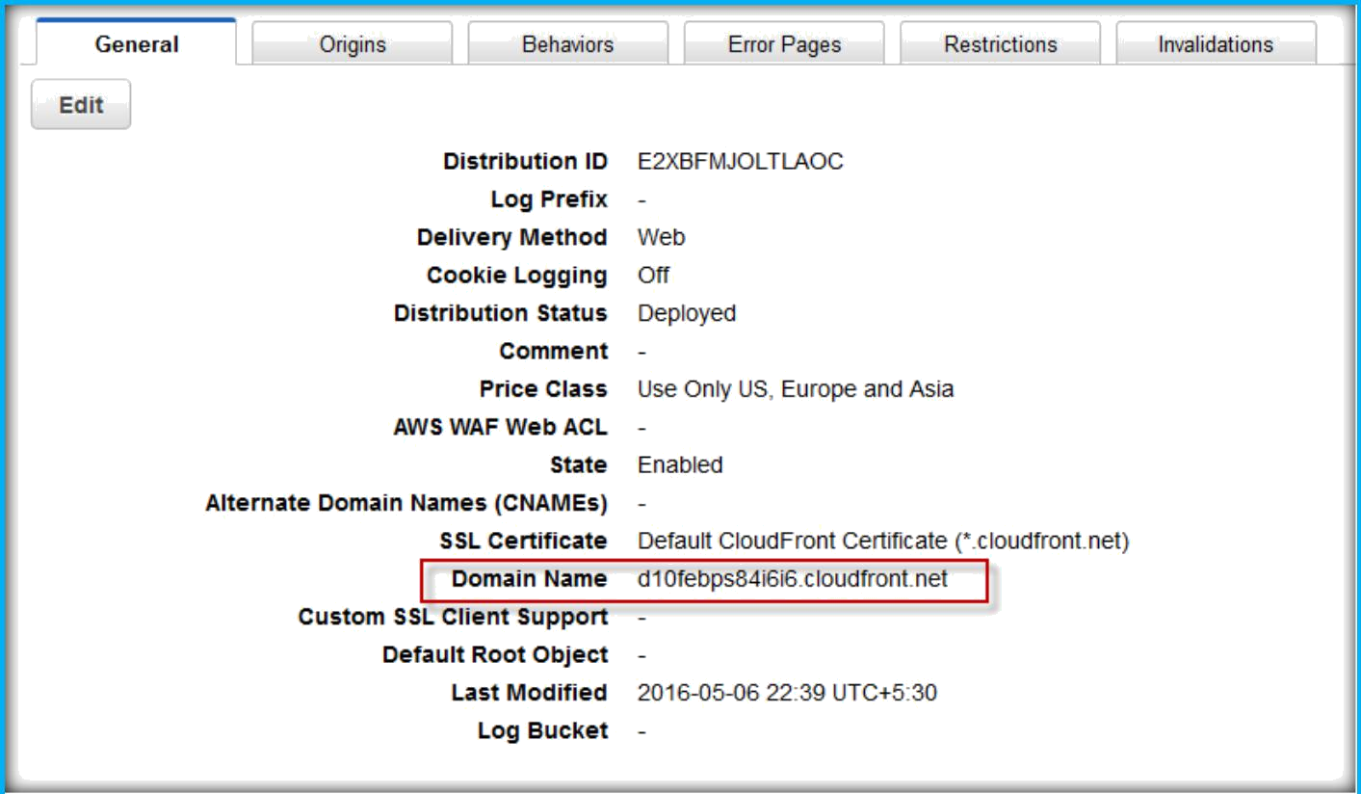
Distribution will start creating, you can see the status as in progress.
Once completion, click on ID.
You can see the domain of your cloudfront distribution under general.

Slide 7
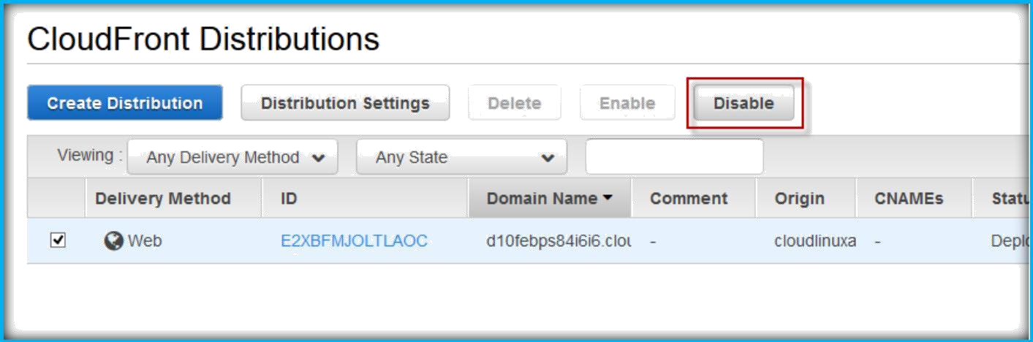
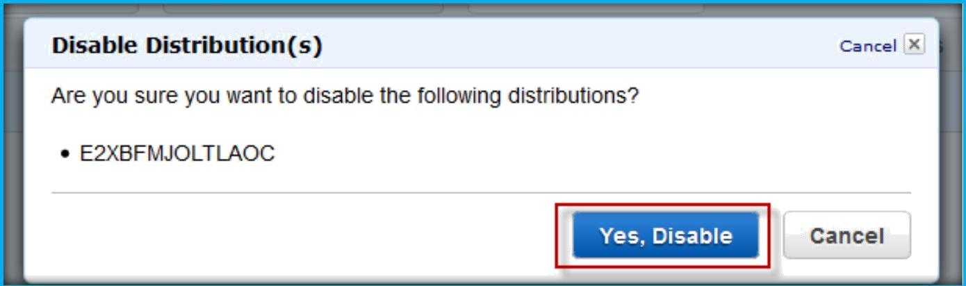
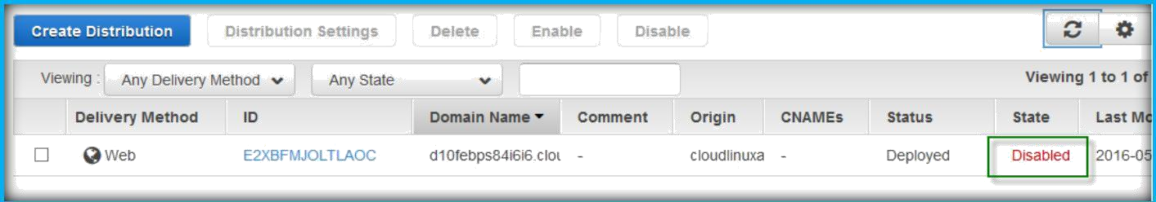
REMOVE CLOUDFRONT DISTRIBUTION
To remove the distribution, select the distribution then choose disable.
Confirm the disabling distribution.
It will start disabling, once done status will change to Disabled.

Slide 8
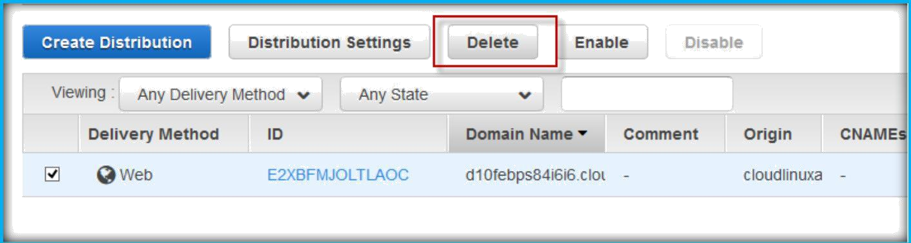
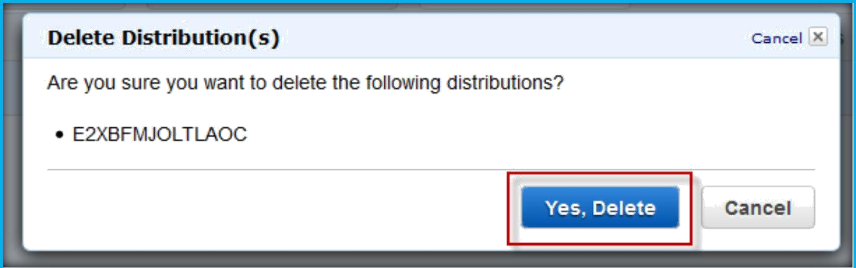
Choose distribution, select Delete to delete the distribution.
Confirm deletion, by clicking on Yes, Delete button.

